Slide 1
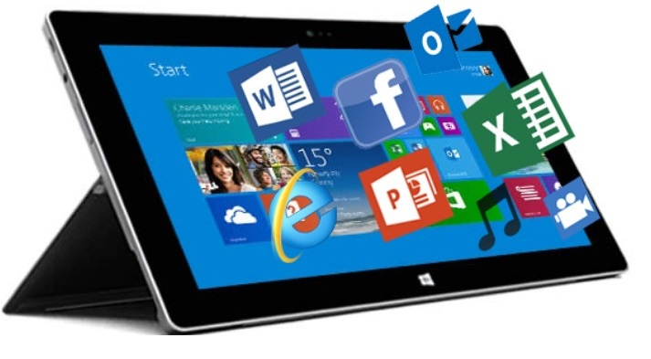
Digital Literacy and Online Communication

Slide 2
The goal is for students to effectively use online tools to communicate with others.

Slide 3
Methods of Digital Communication
We email our friends and coworkers.
We read.

Slide 4
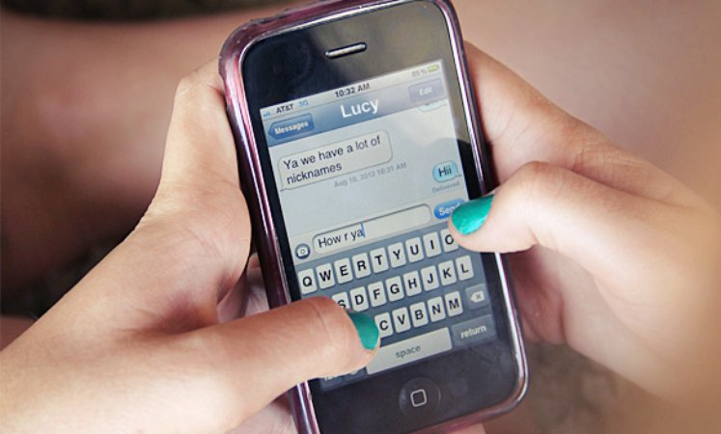
More Methods of Digital Communication
We do our homework.
We text.

Slide 5
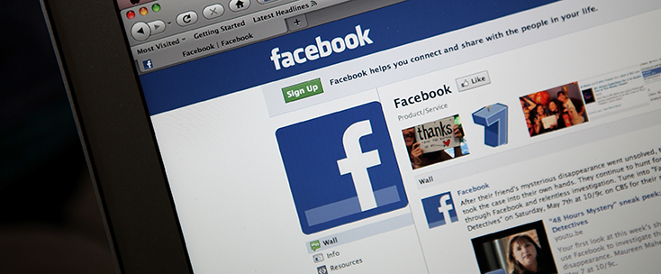
More Methods of Digital Communication
We use social networks to communicate with our friends and family.
We shop.

Slide 6
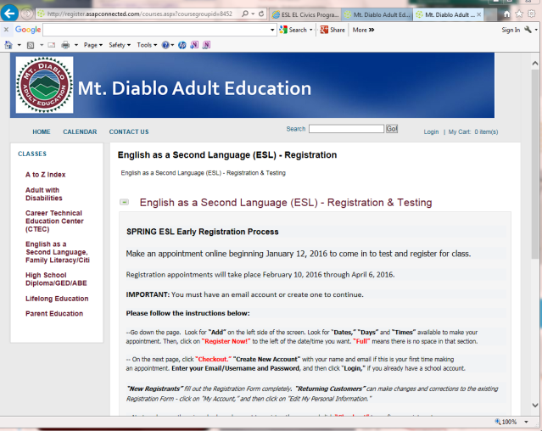
More Methods of Digital Communication
We register for classes.
We take online classes.

Slide 7
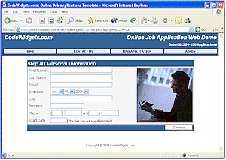
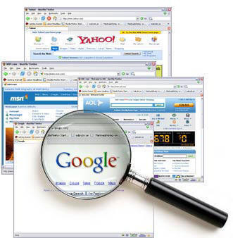
More Methods of Digital Communication
We apply for jobs.
We search for information.

Slide 8
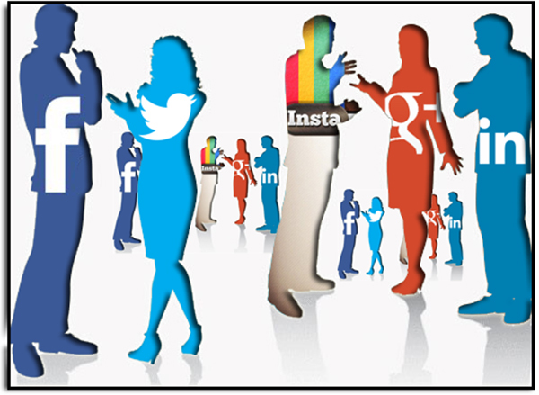
Social Networks
An online website where people can communicate and share information.

Slide 9
Facebook
Facebook is a popular free social networking website.
It lets users:
See messages from other people
Show photos and video
Send messages to friends, family and colleagues.
Share information on your “page”
Invite friends to join groups and events
Play games

Slide 10
Twitter
Twitter is a free social networking service.
It lets users:
Send short messages called “tweets.”
Watch for other users' “tweets.”
Example of a tweet:
Hello Twitter! #myfirstTweet

Slide 11
Instagram
Instagram is a free social networking service.
It lets users:
Share photos
Share videos

Slide 12
Computer Acronyms – Part 1
CPU - Central Processing Unit of the computer. This is similar to the computer’s brain.
IT – Information technology is the use of computers
JPEG – a computer format for pictures
MAC - an abbreviation for Macintosh, a personal computer made by the Apple Computer company
OS - the operating system of the computer. The main program that runs on a computer and begins automatically when the computer is turned on.

Slide 13
Computer Acronyms – Part 2
PC - personal computer
PDF - Portable Document Format, a file format ready for the web
RAM - Random Access Memory is the space inside the computer. If you increase the amount of RAM, then you will increase the computer’s speed.
USB – connects different types of technology
Wifi – allows computers to connect to the internet without wires
www – World Wide Web

Slide 14
Computer Symbols & Emoticons Part 1
Email address sign
On and Off Button
Printer Symbol
Facebook

Slide 15
Computer Symbols & Emoticons Part 2
Attachment
Wifi Symbol
Happy Emoticon
Twitter
: )

